Slide 1


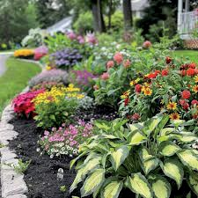
July 2024
Deer Park News – City Manager B J Jetter
Summer is officially here, and activities are in full swing. With more people outdoors, we ask everyone to be mindful of children and adults on bikes when driving. Watch for residents walking and crossing at street corners and intersections. The speed limit in Deer Park is 25 miles per hour. We have received complaints about speeding and rolling stops at stop signs throughout the city. The police department has been conducting directed patrols to reduce these violations. If you have observed repeated rolling stops at stop signs, please report those to the police department so they can monitor traffic in that area.
Plainfield Road! I think we can all agree this has been a long project, but the good news is we are nearing completion. Now that all the new water mains are in, they are working on connecting them to the existing infrastructure. Once that is complete, paving will start in Silverton and continue down through Deer Park. All the paving is expected to be complete by the end of July.
The Chamberlin Park Music Pavilion project is underway. The design team and contractor have met, and the final design has been approved. Construction is set to start immediately following the Festival in the Park in August and will be completed by the end of the year.
The Oakwood Avenue street project is now well underway, the water mains have been installed, and the next phase will be storm sewer and catch basin repairs. As this project moves forward, we hope to see completion by the end of the year.
Blue Ash Road Phase Two survey work has begun, mapping of the utility lines, water mains and sewers needs to be completed before any construction can occur. This survey work should be concluded by the middle or end of July. Phase Two of this project is from Duneden Avenue to the Silverton corporation line. New curbs and parking spaces will be addressed. New, taller light poles like those already installed in Phase One of Blue Ash will be done. Beautification elements will be added (planters and benches, etc.), and we hope to have a large gateway sign welcoming visitors at the entrance to the city from Silverton.
Summer is also bringing changes to the staff at City Hall. After serving 38 years as Administrative Assistant to the City of Deer Park, Janet Kelly has announced her retirement. Janet, you’ve done an excellent job for the Deer Park community. Thank you for all your dedication and hard work over these many years. Your presence will be missed! We all wish you an enjoyable retirement. Janet’s last day is August 31, 2024.
In closing, we have received many complaints about fireworks in the last couple of weeks. Several residents came to the Council meeting to complain and ask for help in enforcing the laws with the July 4th holiday around the corner. If you plan to set off fireworks, familiarize yourself with the laws pertaining to fireworks. Be mindful of people with PTSD and animals who are prone to problems associated with the noise. The council has agreed to review the city’s current policy to be better able to enforce violations. We don’t want banning fireworks to be the only choice they have.
Enjoy the rest of your summer. Be safe, stay hydrated and use sunscreen, and as always, it’s a great time to Re-Discover Deer Park!
2024 Beautification Awards
The City of Deer Park’s Beautification Awards program is a city-wide recognition program that acknowledges businesses, residences, organizations, and other establishments for contributing to the improvement and beautification of our community.
You are encouraged to apply on your own behalf or nominate a friend or neighbor whose property you consider beautiful. The application deadline is 4:00 pm on Friday, July 12, 2024. Winners will be honored at the Days in the Park Festival on Saturday, August 3rd at 7:00 pm Center Stage, and will
receive a certificate, and a temporary acknowledgment sign to be placed in their yard. Applications can be found on the city website in the NEWS section.

Slide 2

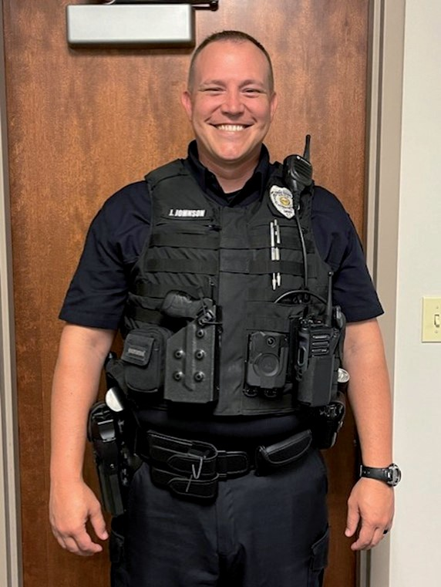
From the Desk of Police Chief David Battin
In May of 2024 the Deer Park Police Department was awarded the “Gold” award from Lexipol Connect for the year 2023.
The Gold Level Recognition is the highest tier of recognition offered by Lexipol, and it signifies the department’s exceptional dedication to ensuring the highest standards of professionalism, transparency, and accountability.
Lexipol is nationally recognized as being the standard in law enforcement. Their policies and procedures are the guidelines used by the Deer Park Police Department. This achievement highlights the department’s tireless
efforts in enhancing officer performance, promoting public trust, and adhering to best practices in law enforcement. Achieving Gold Level is a testament to every department member’s hard work and dedication.
Last year the Police Department sent Officer James Murphy to a grant writing school to help us secure funds for the training, technology and equipment needs of the police department.
Starting in 2023, Officer Murphy worked tirelessly on securing a grant for body cameras for all our officers and earlier this year the grant was approved! All the officers have gone through training on how to use and operate the cameras, and starting June 1st, all Deer Park Police Department officers will be wearing the Axon Body Worn Cameras.
I want to remind everyone to report any suspicious activity in your neighborhood and to be cautious with telephone, email, and social media solicitations. Recently, through a tip from a resident, we were able
to apprehend two individuals and recover over $3500 in stolen items. We continue to receive reports of scammers soliciting residents. We urge residents to not release personal, financial, or identification
information unless you are absolutely sure with whom you are dealing. We remind residents to lock their homes and vehicles and keep your valuables out of sight.
Fire Department Update – Fire Chief Denny Meador
Many families like camping in summer to get away from the bustle of city life and relax. Camping is a great outdoor activity that can be even more enjoyable when you take these simple safety precautions.
If you are using a tent, be sure it is flame-resistant. Read the tent’s manufacturer’s labels before purchase.
Pitch your tent at least 15 feet away and upwind from campfires.
Clear a three-foot area around the tent, free of leaves, dry grass, and pine needles.
Never use an open flame inside a tent, including fuel-burning lanterns, candles, stoves, or grills. Use only battery-operated lights.
Always keep a fire extinguisher or bucket of water nearby.
Have an escape plan. You may need to cut your way out of the tent if a fire occurs.
Backyard campfires, making s’mores, can be fun but make sure you follow these safety tips.
Build your campfire away from overhanging branches, dry grass, and leaves.
Clear a ten-foot-wide circle around the campfire of any burnable material. This will keep a small campfire from spreading.
Keep the campfire small. Surround it with rocks.
Keep water or a fire extinguisher handy.
Never leave the fire unattended. Before leaving the campfire, drown it in water or cover it with dirt or sand.
Don’t wear loose-fitting clothing near campfires or grills.
Use dry twigs – not gasoline or a liquid starter – to freshen a campfire.
Page 2 City of Deer Park Newsletter

Slide 3


Service Department Update – Jake Preston
As we move into the heart of summer the service department will be upgrading the street signs throughout the city. This project will start on the north side of the city and move south. This will be a multiyear project to complete. You can see some of the new signs up at Wentworth and at Lake & Hoffman.
The service department just completed their yearly storm water training and inspection. The inspectors were impressed with the cleanliness of our shop and mentioned that most inspections don’t go this easily.
Park preparations were made for the Memorial Day Parade, which included landscaping and mulching throughout the park. With those preparations, a Space Force flag has been added to our memorial, currently it is located under the Air Force flag while we work through a permanent location for it.
Park maintenance and improvements will continue throughout the summer as we prepare for the Days in the Park festival in early August.
Check out these upcoming events at the Deer Park Library
Movie Matinee – Every Monday 10:30am-12:30pm
Enjoy the cool air and a weekly Monday movie here at the Deer Park Branch Library. Bring your own snacks! Seating is limited, but we’ll make room for all!
Take & Make – New kits available every Friday
If you’re looking for something to do these summer weekends with your kiddos, grab one of our take and make kits! New kits are available every Friday from June 7 through July 26. Available while supplies last.
Engaging Seniors – Smart Phone Basics – Sept. 4th 1:30-3:30pm
Are you afraid to use your smartphone? Join EngAging Seniors for a small group instruction to boost your skills and confidence in using your smartphone. This is a series of four classes and attendees are required to attend all four. Other classes are on Sept. 11th, 18th and 25th, 1:30-3:30pm. These classes fill up fast, so mark your calendar and register with the library by calling 513-369-4450, option 2.
The Deer Park Silverton Joint Fire District offers free certified child car seat installation, free of charge to all residents of the fire district. Please contact Captain Kevin Rogers to schedule your appointment.
(513) 791-2500
The Deer Park Police Department offers free vacation home checks to all residents while you are out of town. To request this service, visit the Police Department page on the city website and select the Vacation Home Check form, from the menu on the left side of the page.
Finally cleaning out that garage, basement or closet? Did you know the city has a dump truck that can be rented from April through September, for just one night or over a weekend. We drop it off, you load it up; we haul it to Rumpke! The cost is $150 per load. To rent, contact the city office for more information or to check availability. Phone: 513-794-8860.
Summer is a great time for a yard sale. Here are the current Yard Sales rules for Deer Park: Residents are reminded that although currently there is no fee or permit required for a yard or garage sale, there are regulations by ordinance, including:
hours are not to be before 9 am or after 9 pm
sale to be no longer than 4 days in duration
no more than 4 sales in a twelve-month period
any signs posted need to be removed asap after the event
City of Deer Park Newsletter Page 3

Slide 4
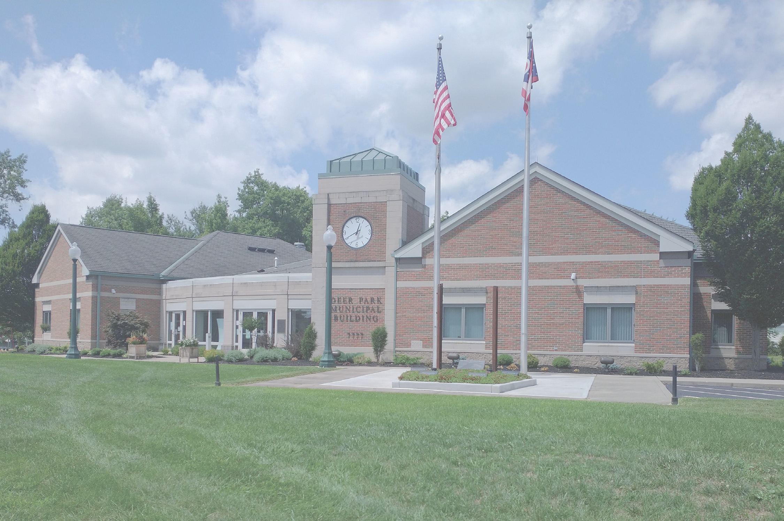

City of Deer Park 7777 Blue Ash Road
Deer Park, Ohio 45236
Presorted Standard
U.S. Postage
PAID
Cincinnati, OH Permit #1542
Summer Concert Series 2024
All concerts take place on Saturday 7 pm – 10:00 pm (except for 7-14 Sunday 4-6pm)
in the Upper Shelter at Chamberlin Park.
Sat Jul 6
Sun Jul 14
Sat Aug 17
Sat Aug 31
Sat Sep 14
Vinyl Countdown - 80’s new wave; pop/arena rock Jumpin Jive Big Band - Big Band music 4 pm - 6 pm String Theory - multi genre, 40’s to present
The Gamut - 80’s to present; rock
Paisley Cain - classic rock with a twist, harmony vocals
Mark your calendars for these upcoming events
Days in the Park Festival – August 2nd & 3rd 6 pm to midnight
Friday, Aug 2 - Band @ 8 pm: The Remains Saturday, Aug 3 - Band @ 8 pm: Cassette Junkies Fireworks @ 10 pm on Saturday night
VOLUNTEERS ARE NEEDED – If you are interested in helping, please contact the city office at 513-794-8860.
Touch a Truck – Sunday, September 22nd in Chamberlin Park
The Park Board is currently planning this community involvement event for children and adults of all ages to get an up-close, hands-on experience with the vehicles and equipment used by the Deer Park Police and Service Departments. The truck lineup is not finalized yet, but plans are to include as many vehicles as possible. They are reaching out to Hamilton County and community
hospitals for a possible air care helicopter. They also plan to invite Food Trucks. YUM! Watch for more details as this event continues to come together!

